Slide 1








Climate Change
in cooperation with

Slide 2


    Introductions
Name
Company
Background

Slide 3
    Objectives
Recognize climate change
Realise climate change impacts
Calculate carbon footprint
Identify appropriate activities to reduce carbon footprint
Manage stakeholder expectations

Slide 4
    Modules
Module 1: Sustainability and climate change
Module 2: Stakeholder identification
Module 3: Initiatives for climate change
Module 4: Calculating Greenhouse Gas emissions
Module 5: Carbon management strategy

Slide 5
Module 1
Sustainability and Climate Change
A brave glance towards a greener future

Slide 6
    Sustainability
What is Sustainability all about?

Slide 7
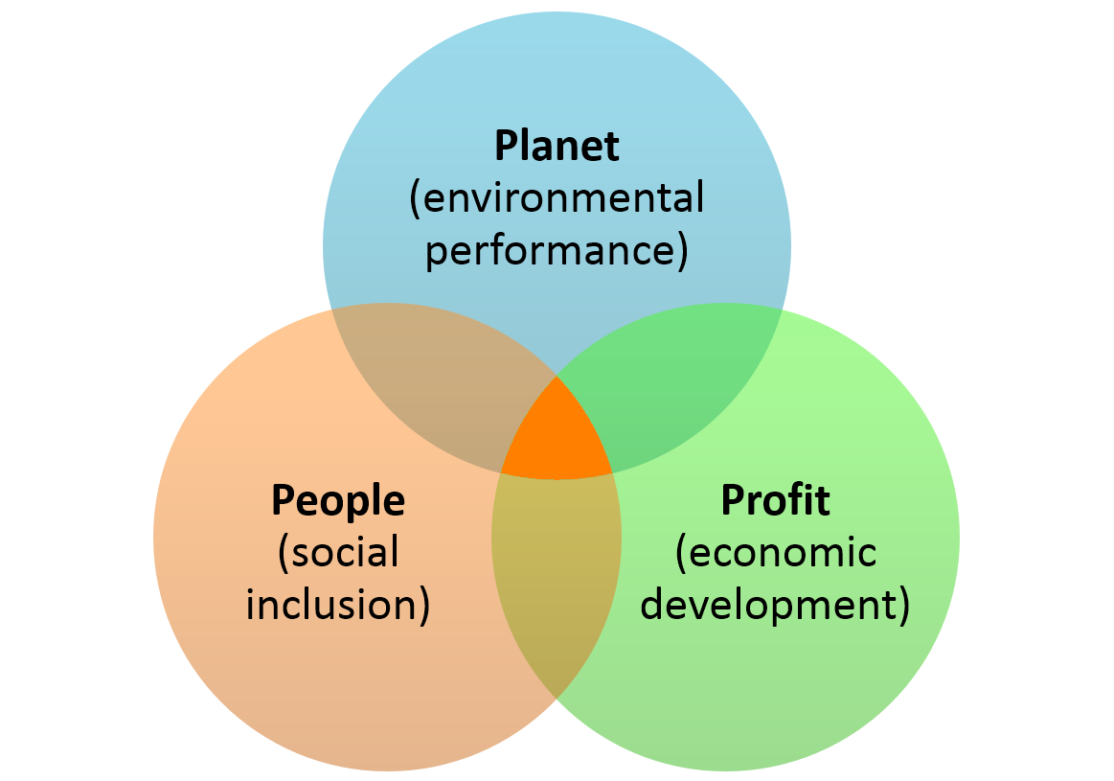
    Sustainability approach
Planet (environmental performance)
Profit (economic development)
People (social inclusion)

Slide 8
    Sustainability goals
Economic Development, effectiveness and prosperity
Environmental quality, protection and performance
Social equity, inclusion and justice
Simultaneous pursuit of

Slide 9
    Sustainability & Sustainable Development
Sustainability: The ability or capacity of something to be maintained or to sustain itself, to support, or endure.
Sustainable development: The development that meets the needs of the present without compromising the ability of future generations to meet their own needs. (Gro Brundtland, World Commission on Environment and Development (WCED), 1987)

Slide 10
    Benefits
What are the benefits?

Slide 11
    Benefits for Companies from Implementation
Improved reputation
Better risk management
Improved customer retention
Improved innovation, competitiveness and market positioning
Enhanced operational efficiencies and cost savings
Cost efficient supply chain
Access to capital
Improved relations with regulators
Building and sustaining shareholder value
Enhanced ability to address change
Notes:
securing its continued license to operate

Slide 12

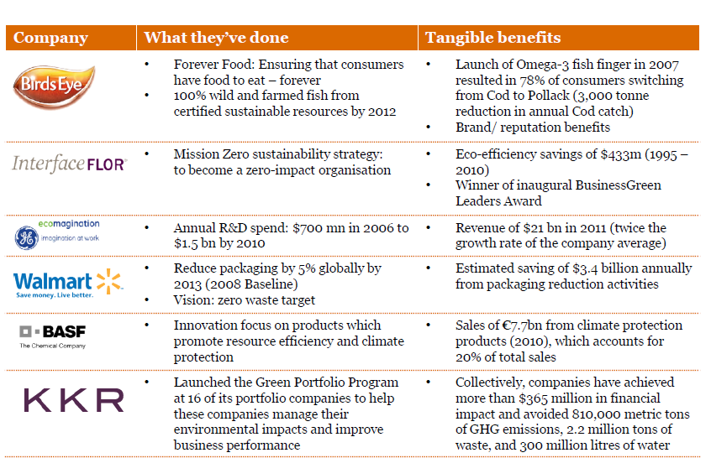
    The Business Case for Sustainability
Notes:
Pwc report examples of value creation

Slide 13
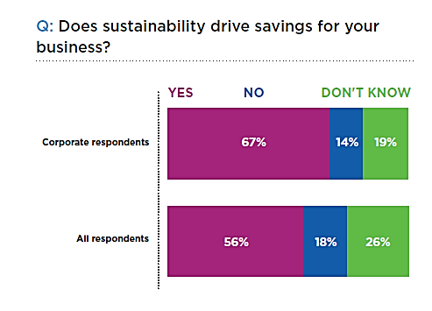
    The Business Case
Ethical Corporation, The State of Sustainability 2015

Slide 14
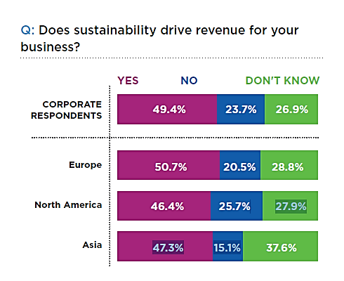
    The Business Case
Ethical Corporation, The State of Sustainability 2015

Slide 15

    Sustainable Development Goals
The Goals and targets will stimulate action over the next fifteen
years in areas of critical importance for humanity and the planet

Slide 16

    What Do We Mean by Climate Change?

Slide 17
    Some Definitions
Weather: The state of the atmosphere at a particular place and time as regards heat, cloudiness, dryness, sunshine, wind, rain
Climate:
Long Term - Wide Area
Seasonal Changes
Measured over long spans of time
Climate Change: The significant change in the measures of climate, lasting for an extended period of time.
Global Warming: The recent and ongoing global average increase in temperature near the Earths surface.
Climate Disruption: The summary of unwanted and unnatural change in climate.
Greenhouse Gases: Any gas that absorbs infrared radiation in the atmosphere. CO₂, CH₄, N₂O, O₃, CFCs, HCFCs, HFCs, PFCs, SF₆. [4]
Mitigation Actions: Human interventions to reduce the human impact on the climate system; they include strategies to reduce greenhouse gas sources and emissions and enhancing greenhouse gas sinks.
Adaptation Actions: Adjustment in natural or human systems in response to actual or expected climatic stimuli or their effects, which moderates harm or exploits beneficial opportunities.
Resilience: A capability to anticipate, prepare for, respond to, and recover from significant multi-hazard threats with minimum damage to social well-being, the economy, and the environment.
Notes:
EPA definitions
Increases of carbon dioxide, methane, and nitrous oxide in the earth’s atmosphere throw the planet’s highly sensitive ecosystem off-balance. This climate change, or greenhouse effect or global warming, results when gases trap warmth in the earth’s atmosphere instead of letting the atmosphere release it.

Slide 18
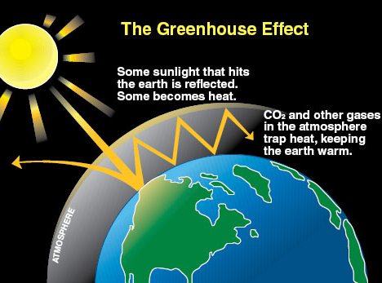

Slide 19
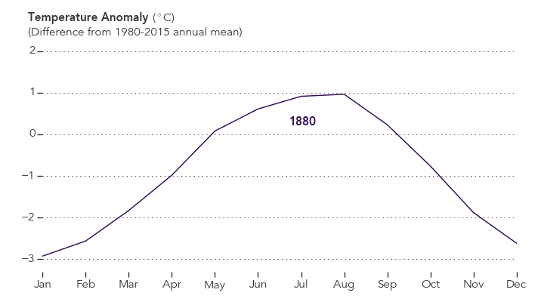
    Evidence that Climate is Changing
Global average
temperature has increased
by 0,19 ºC since 1880,
according to NASA.
http://earthobservatory.nasa.gov/blogs/earthmatters/2016/09/12/heres-how-the-warmest-august-in-136-years-looks-in-chart-form/
Artic ice minimum reduced by 13,4% per decade
Carbon Dioxide raise to 404.07 parts per million
Notes:
The figure is GIF (plays when you put ppt on presentation mode)

Slide 20
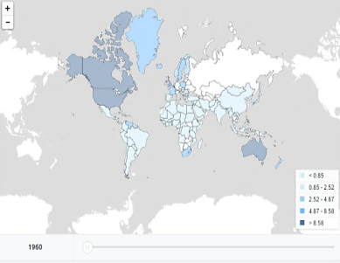
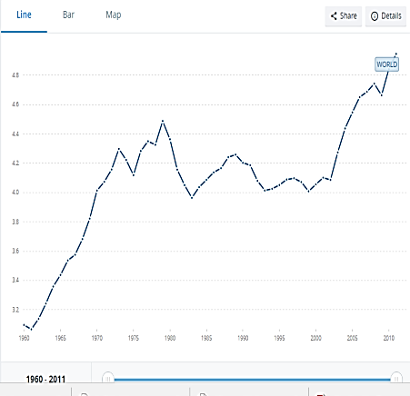
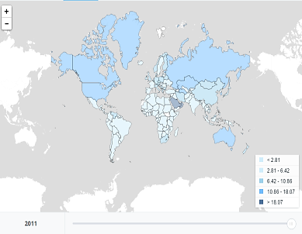
CO2 emissions (metric tons per capita)
    Evidence
Notes:
2011 is the latest year of available data
World map 1960 and 2011
http://data.worldbank.org/indicator/EN.ATM.CO2E.PC?end=2011&start=1960&view=chart

Slide 21
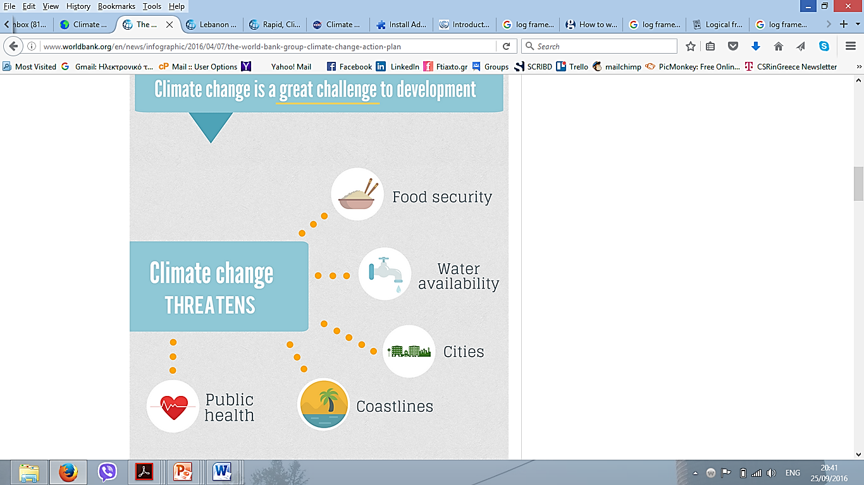
    Climate Change Impacts
http://www.worldbank.org/en/news/infographic/2016/04/07/the-world-bank-group-climate-change-action-plan
Notes:
http://www.worldbank.org/en/news/infographic/2016/04/07/the-world-bank-group-climate-change-action-plan

Slide 22
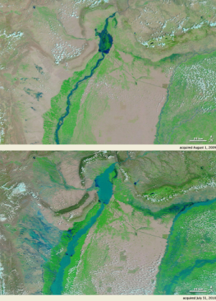

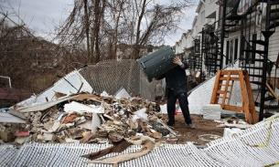
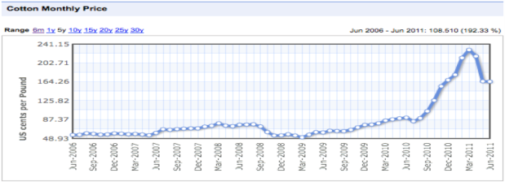
    Climate Change Impacts
Vast portions of Europe on the Mediterranean coastline, especially Italy, Greece, and France, may become completely inhospitable to grape production by 2050.
Colder-than normal temperatures lead to incomplete ripening with high acid, low sugar, and unripe flavours (whereas) warmer-than-normal temperatures create overripe fruit with low acid, high sugar, high alcohol and cooked flavours. (Mozel et al 2014, Wine Economics and Policy)
Lloyd's says damage and weather-related losses around the world have increased from an annual average of $50bn in the 1980s to close to $200bn over the last 10 years. (May 8, 2014. The Guardian)

Slide 23
    Lebanese Emissions with the World
Emissions of Lebanon in comparison with the region and the world- year 2000
Notes:
http://www.worldbank.org/en/news/infographic/2016/04/07/the-world-bank-group-climate-change-action-plan

Slide 24
    Lebanese Indicators Vs the World
Emission indicators of Lebanon in comparison with the region and the world- year 2000
Notes:
http://www.worldbank.org/en/news/infographic/2016/04/07/the-world-bank-group-climate-change-action-plan

Slide 25
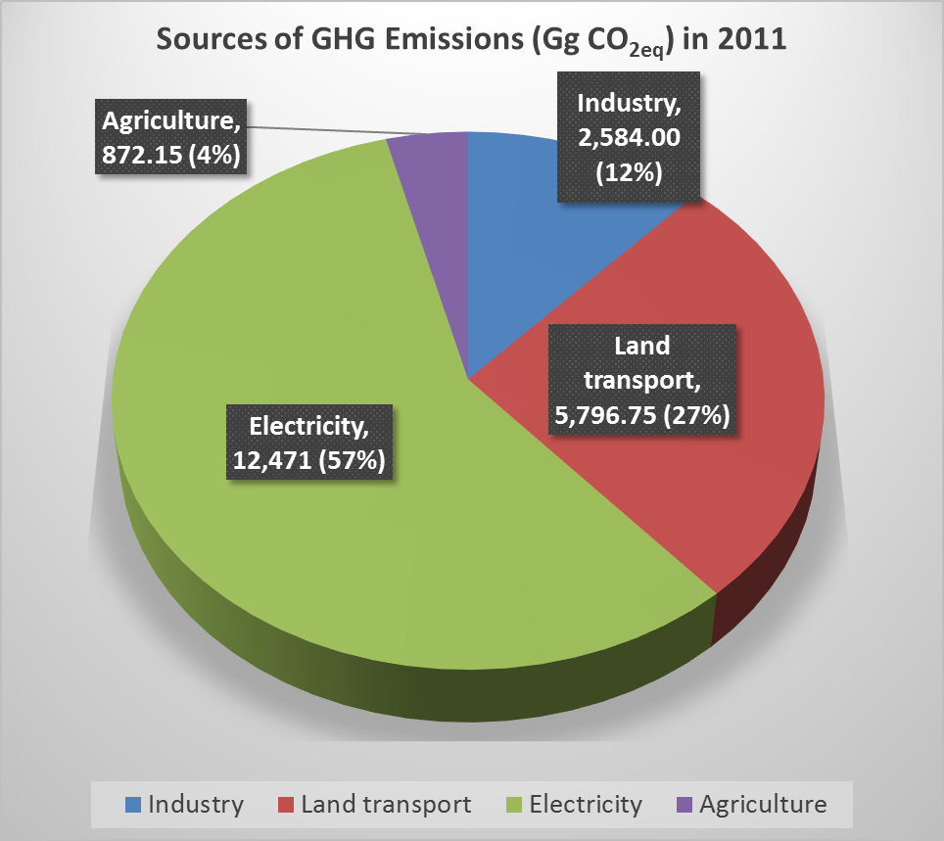
    Lebanese GHG Emissions
Lebanese inventory, 2015. http://climatechange.moe.gov.lb/publications
Notes:
http://www.worldbank.org/en/news/infographic/2016/04/07/the-world-bank-group-climate-change-action-plan

Slide 26
https://www.youtube.com/watch?v=d92ZiVFxHlA

Slide 27
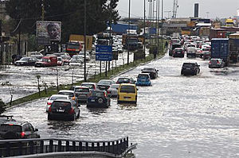
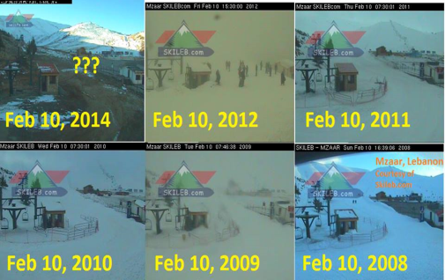
    Climate Change Impacts on Lebanon
Notes:
http://www.pewglobal.org/files/2015/11/Climate-Change-Report-26.png

Slide 28
    Climate Change Impacts on Lebanon
Main Climate Projections by 2090
3.5ºC 5ºC
Temperature increase
25%
45%
Rainfall decrease
50
Additional hot summer days (Tmax > 35ºC)
Second National communication, 2011
34
Additional tropical nights (Tmin > 25ºC)
18
Days increase on drought period

Slide 29
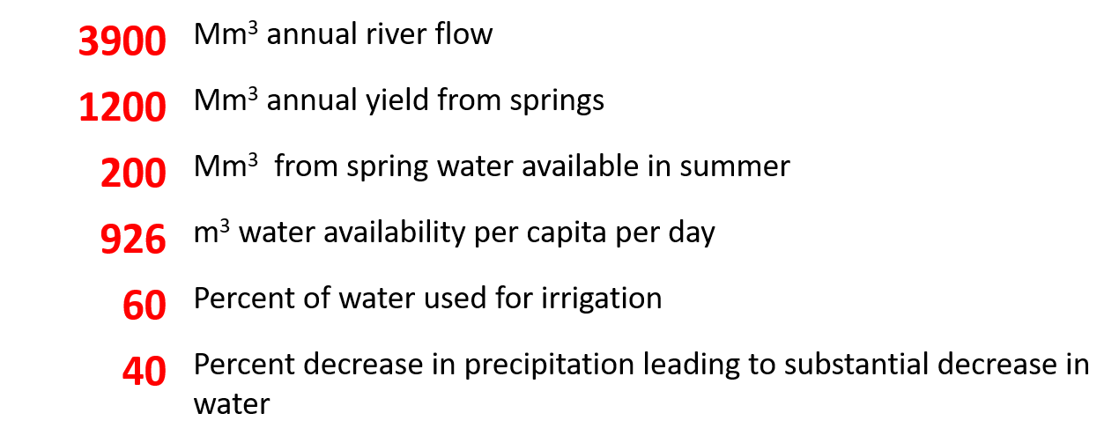
    Climate Change Impacts on Lebanon
Impacts of Climate Change on Water in Lebanon

Slide 30
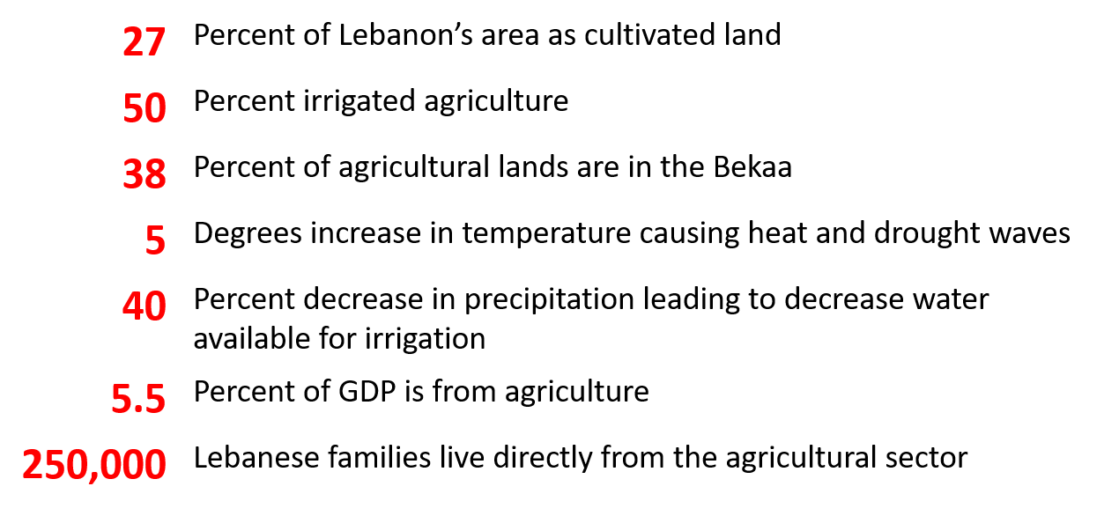
    Climate Change Impacts on Lebanon
Impacts of Climate Change on Agriculture in Lebanon

Slide 31
    Climate Change Impacts on Lebanon
Impacts of on coastal zones and infrastructure
Sea flooding and inundation due to increase in the mean sea level, or in the frequency and intensity of episodic events
Sea water intrusion due to overexploitation of groundwater
Coastal erosion which could lead to a loss of sandy beaches
Financial losses in coastal and marine economic activities (tourism, agriculture, fisheries, transportation)

Slide 32
    Climate Change Impacts on Lebanon

Slide 33
    Climate Change Impacts on YOUR Business
Climate Change causes serious impacts on business:
In Lebanon, the total costs might equal USD 1,900 million in 2020, rising to USD 138,900 million in 2080 (Economic Costs to Lebanon from Climate Change: A First Look, MOE 2015).
Sickness Days
Export
Absence of Employees
Brand Perception
Raw Material
Utility Bill
Productivity
Water Bill

Slide 34
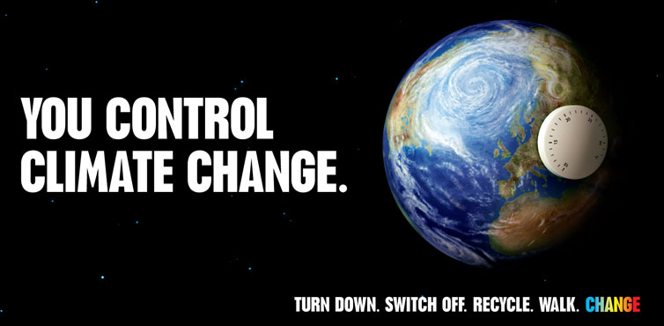

Slide 35
    Burning questions
Where to start from?
What is it really all about?
Why should I do it?
How to measure progress and impact?
What can I do?
Who will be involved?

Slide 36
Module 2
Stakeholder Management
How to effectively engage with stakeholders

Slide 37
Key Questions
What do we mean by stakeholders?
Why are they so important
How can I recognise them
What is stakeholder engagement and what are the benefits?

Slide 38
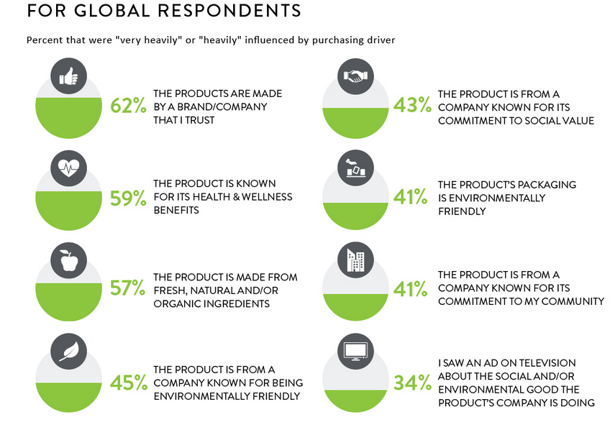
    International Trends
Nielsen 2015, Nielsen’s Global Corporate Sustainability Report
Notes:
For global respondents

Slide 39
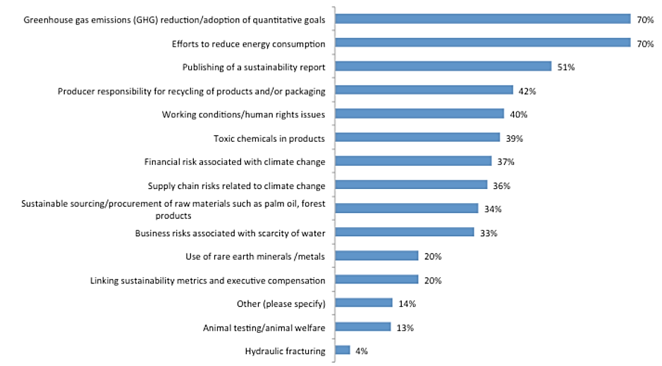
    Sustainability Related Topics
    Shareholders and Investors ask about
Notes:
State of profession

Slide 40

    Stakeholders
Individuals or groups who are affected directly or indirectly by the company activities or affect company activities & decisions.

Slide 41
    Stakeholders
Company
Suppliers
General public
Clients
Local Community
Unions
Advertisers
Financial Analysts
Shareholders
MPs
NGOs
community
Government
Competitors
Users

Slide 42

    Exercise
Identification and prioritisation of Stakeholders
Work in teams
Select an organization
Identify the Stakeholder groups for your organization
Prioritize the stakeholders

Slide 43
    Exercise
Stakeholders (Groups & Subgroups) | Risk/ Opportunity (1-5) | Impact (1-5) | Probability (Risk*Impact) (1-25) | Priority

Slide 44
    Need to consider
Time & Resources required for stakeholder engagement
Manage expectations of stakeholders and company
Lack of transparency
Current Corporate Culture
Some stakeholders may be under/over estimated
Parties not seeing the importance of the engagement
Effective facilitation may need external help
Need for senior endorsement
Identifying the starting point
Fear of Change
Who is the driver –the company or the stakeholder?

Slide 45
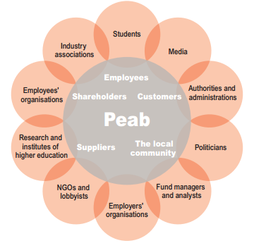
    Stakeholders
Notes:
Peab 2015 SustainablityReport

Slide 46
Key learning points

Slide 47
Module 3
Environmental initiatives
Which suit my company best?

Slide 48
Key Questions
What are the key topics that impact us more?
What are the key topics that we need to focus on?
How can I identify these topics?

Slide 49
    Climate change topics
Climate Change
Emissions
Biodiversity & forestry
Electricity
Materials and raw materials
Waste
Product & Operational Efficiency
Packaging
Transportation
Water management
Supply Chain emissions
Local identity/context
Disaster recovery
They are all important!
But where should my company focus???

Slide 50
    Exercise
Break into 5 teams
Each group represents one sector/company
Group 1: Construction company
Group 2: Hotel
Group 3: Facilities Management company
Group 4: Cloths& Accessories Import company
Or Group 5: your company

Slide 51
    Early approach
Consider the topics in the previous slide
Which are the 5 most important for your business to tackle
Priority | Topic
1
2
3
4
5

Slide 52

    Proven approach

Slide 53
    Lets ask some questions
Is it already mentioned as important by stakeholders?
Does this constitute a future challenge/ opportunity for your sector?
Is this connected to laws, regulations, or international agreement?
Does it have significant financial risks/implications for your organization?
Is this recognized by scientists/experts as a risk to climate change?
Does your organization have knowledge/competencies to innovate on this issue?

Slide 54
    Key questions
Topic | Q1 Important for stakeholders? | Q2 Future challenge/opportunity for your sector? | Q3 Connected to laws, regulations, international agreements? | Q4 Financial risks/implications for your organization? | Q5 Recognized by experts as a risk to sustainability? | Q6 Have knowledge/ competencies to innovate on this issue? | Total
1
2
3
4
5
Scale: 0-3, Maximum Total Score: 18, Minimum Total Score: 0

Slide 55
    What do stakeholders think?
How important is this topic for stakeholders?
Topic | Stakeholder 1 | Stakeholder 2 | Stakeholder 3 | Stakeholder 4 | Stakeholder 5 | Stakeholder 6 | TOTAL SCORE
1
2
3
4
5
Scale: 0-3, Maximum Total Score: 18, Minimum Total Score: 0

Slide 56
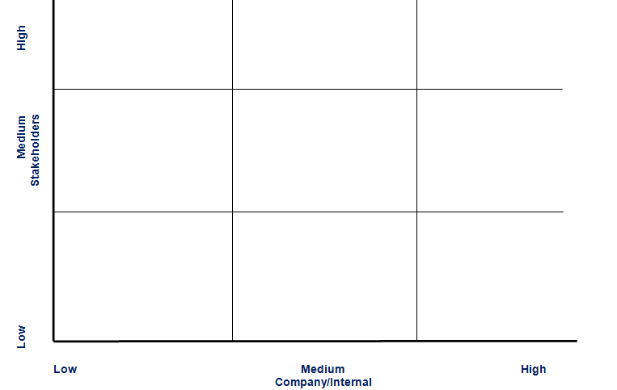
    Plot

Slide 57
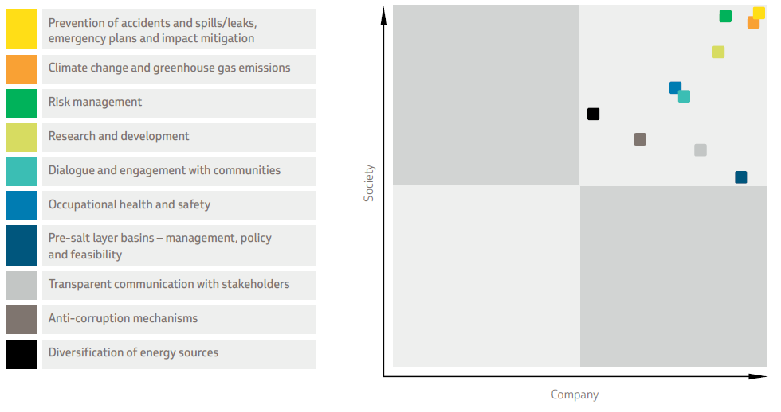
Materiality Assessment
    Materiality Matrix-Petrobras
Notes:
Petrobras, 2012 Sustainability Report

Slide 58


    Compare!
Method A
Method B
Priority | Topic
1
2
3
4
5
Notes:
Petrobras, 2012 Sustainability Report

Slide 59
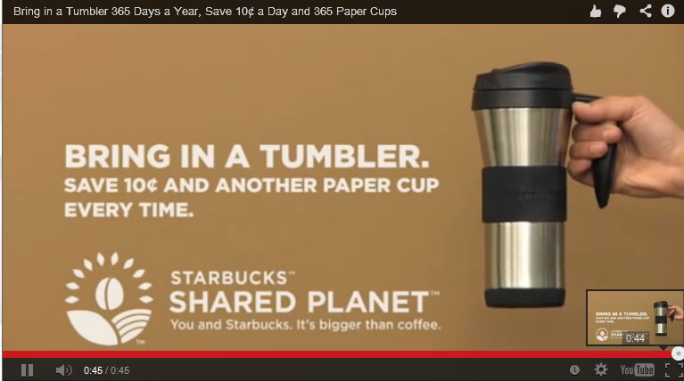
    Examples
Notes:
Ads+social change http://inventorspot.com/articles/marketing_with_a_conscience_7_ads_promoting_social_change_17018

Slide 60
Key learning points

Slide 61
Module 4
Greenhouse Gas Emissions
Understanding & calculating your footprint

Slide 62
Key Questions
What is the Greenhouse Gas protocol
How can we identify Scope 1,2,3 emissions

Slide 63
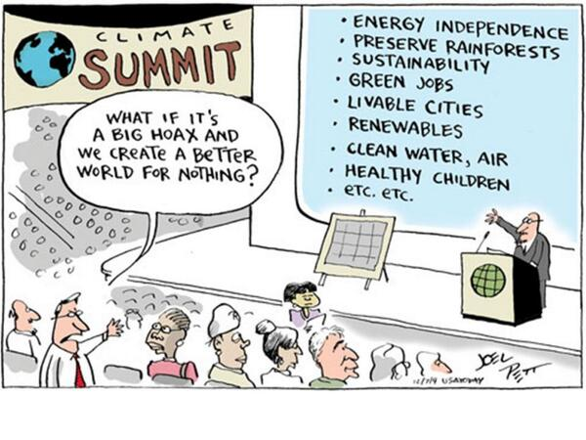
    A Big Hoax?

Slide 64
    The Greenhouse Gases (GHG)
Production Based Accounting
National Consumption and Trade
Indirect Emissions
Calculation
Consumption Based Accounting
Mostly used among corporate
Allow Sectoral Comparison
Real Consumption (Input-Output)

Slide 65



    Greenhouse Gas (GHG) Protocol
    Corporate Standard
The Greenhouse Gas Protocol (GHG Protocol) is the most widely used international accounting tool for government and business leaders to understand, quantify, and manage greenhouse gas emissions.
Facilitates the preparation of emission inventories through standardised approaches and principles.
Simplifies and reduces the cost of inventories
Provides information to businesses for the development of a climate change strategy.
Promotes inventory consistency and transparency
In 2006 it was adopted by ISO 14064-1
Notes:
The GHG Protocol, is partnership between the World Resources Institute (WRI) and the World Business Council for Sustainable Development (WBCSD)
Here we will do a brief presentation of the Greenhouse Gas Protocol.
The GHG Protocol was first published in 2001 and was revised in 2004, by the World Business Council for Sustainable Development and the World Resources Institute.
The GHG Protocol has the following aims:
To Facilitate the preparation of emission inventories through standardised approaches and principles.
To Simplify and reduce the cost of inventories
To Provide information to businesses for the development of a climate change strategy.
To Promote inventory consistency and transparency

Slide 66










    The Greenhouse Gas Protocol
    Corporate Standard is Recommended by

Slide 67
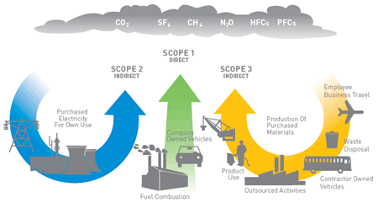



    The Greenhouse Gas Protocol
    Corporate Standard - Components
NF₃
Reported data
Fugitive
Emissions
Required data

Slide 68
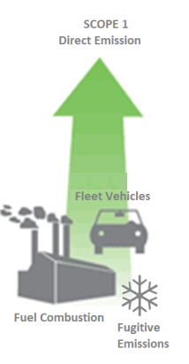
    Required Data – Scope 1
The required are always available in any company that has an accountant!
Data on power production from owned generators
Data on land transportation using fleet vehicles
Data on diesel consumption in boilers
Data on gas consumption
Data on refrigerant gases
Data on anesthesia gases (case of medical facilities)
Data on gases used for printing labels
GHG Protocol
Mandatory!

Slide 69
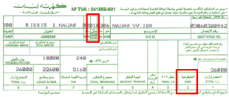
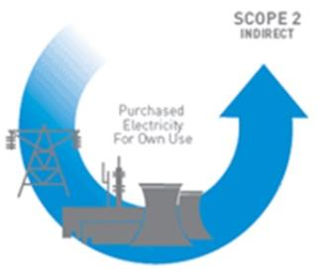
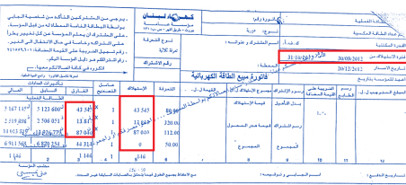
    Required Data – Scope 2
The required are always available in any company that has an accountant!
Data on electricity purchased from local utilities (EDL)
Data on electricity purchased from “shared generator” (Ishtirak)
Data on electricity purchased from RE
GHG Protocol
Mandatory!
SCOPE 2
Indirect
Purchase of electricity for own use

Slide 70
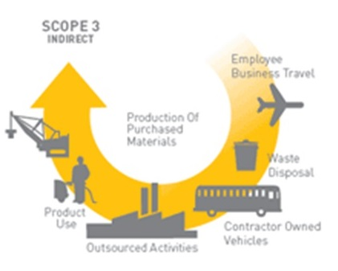
    Required Data – Scope 3
The required are always available in any company that has an accountant!
GHG Protocol
Data on flight trips
Data on paper consumption
Data on employees’ commuting to work
Data on fleet rented for work reasons
Courier services…
Facultative!

Slide 71
    Measuring CO2
Exercise: Measure carbon footprint
Identify the Scope 1, Scope 2 and Scope 3 emissions for the companies of the following sectors :
Group 1: Construction company
Group 2: Hotel
Group 3: Facilities Management company
Group 4: Banking sector
Group 5: Cloths& Accessories Import company
2) Use the calculator to measure the company footprint
Notes:
Define the goal and scope of the study
Making a model of the product life cycle with all environmental inputs and outputs. The data collection effort is usually referred to as the life cycle inventory (LCI) stage
Understanding the environmental relevance of all the inputs and outputs. This is referred to as the life cycle impact assessment (LCIA) phase
The interpretation of the study

Slide 72
    Exercise 2
 | Employees Cars |  | Fleet Vehicles |  | Flight trips
Company A | Driven Km | Type of Car | Driven Km | Type of Car | Km x Passengers x Seat Class
Construction Company | 450,000 | Passenger - 2010 - Gasoline | 180,000 120,000 | Passenger - 2014 - Gasoline Heavy Duty Vehicle –Rigid - 2010 - Diesel | 2,144 km x 2 passengers x Business
Hotel | - |  | 60,000 |  | 1,390 km x 4 passengers x Economy
FM | 150,000 | Passenger - 2010 - Gasoline | 750,000 | Light Good Vehicles – 2013 - Diesel | 237 x 14 passengers x Economy
Cloths& Accessories Import | 70,000 | Passenger - 2012 - Gasoline | 100,000 | Passenger - 2010 - Gasoline | 3,193 x 16 x Economy
 | Area (m²) | Employees | EDL (kWh) | Diesel (L) | Refrigerants | Paper | Shared Generator (380V)
Company A |  |  |  |  | kg of R22 | Packs of A4 | A | H
Construction | 750 | 40 | 90,000 | 67,000 | 15 | 360 | 25 | 2,190
Hotel | 1,250 | 60 | 345,000 | 60,000 | 38 | 120 | 0 | -
FM | 550 | 15 | 20,000 | 10,000 | 15 | 360 | 50 | 3,468
Cloths&Acc Import | 850 | 25 | 40,000 | 150 | 0 | 50 | 30 | 1460

Slide 73
    The Carbon Footprint of 5 companies
 | EDL | Diesel | Refrigerant | Paper | Shared Generator | Fleet Vehicles | Flight trips | Employees cars | Total
Construction Company | 58.5 | 184.5 | 21.8 | 1.5 | 37.4 | 128.6 | 0.6 | 106.9 | 539.6
Hotel | 224.3 | 165.2 | 57.0 | 0.5 | 0.0 | 14.2 | 0.5 | 0.0 | 461.6
FM | 13.0 | 27.5 | 22.5 | 1.5 | 118.5 | 58,288.2 | 0.6 | 35.6 | 58,507.4
Cloths& Acc. Import | 19.5 | 0.4 | 0.0 | 0.2 | 20.0 | 23.7 | 70.8 | 16.6 | 151.3
 | Total (tCO2e) | Area (m2) | Employees | tCO2e/m2 | tCO2e/Emp.
Construction Company | 539.6 | 750.0 | 40.0 | 0.7 | 13.5
Hotel | 461.6 | 1,250.0 | 60.0 | 0.4 | 7.7
FM | 58,507.4 | 550.0 | 15.0 | 106.4 | 3,900.5
Cloths& Acc. Import | 151.3 | 850.0 | 25.0 | 0.2 | 6.1

Slide 74
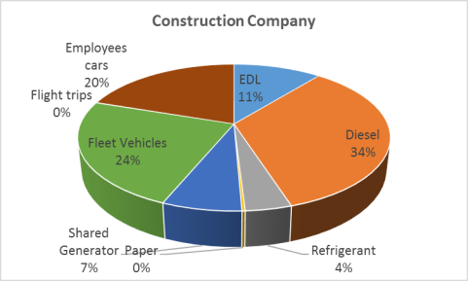
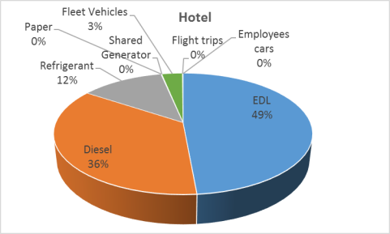
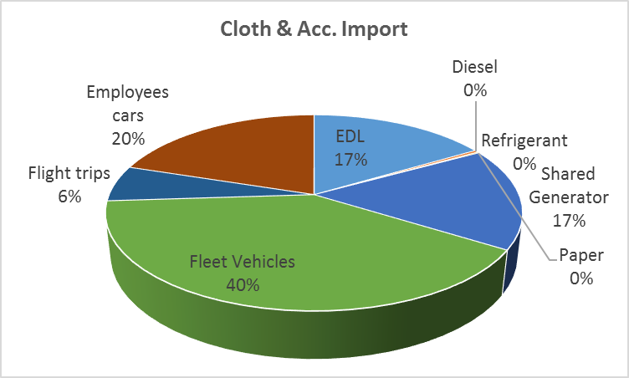
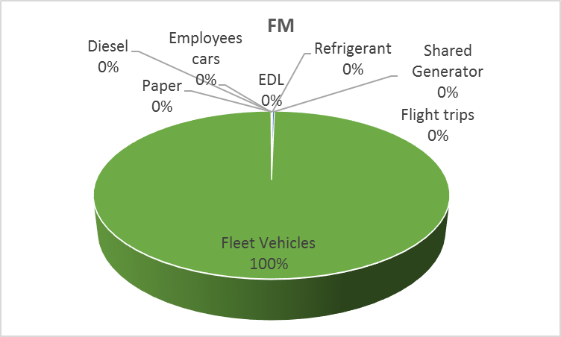
    The Carbon Footprint of 5 companies

Slide 75
    The Carbon Footprint of 5 companies
http://climatechange.moe.gov.lb/newsghgreporting
MOE Tool

Slide 76
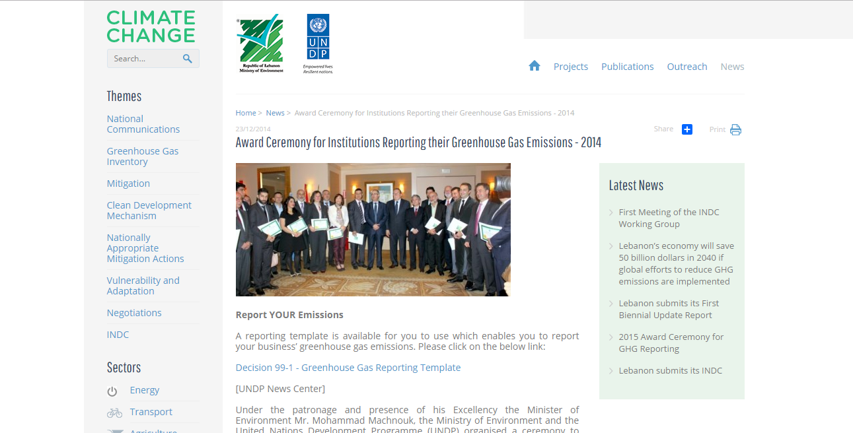
    The Carbon Footprint of 5 companies
http://climatechange.moe.gov.lb/newsghgreporting
MOE Tool

Slide 77
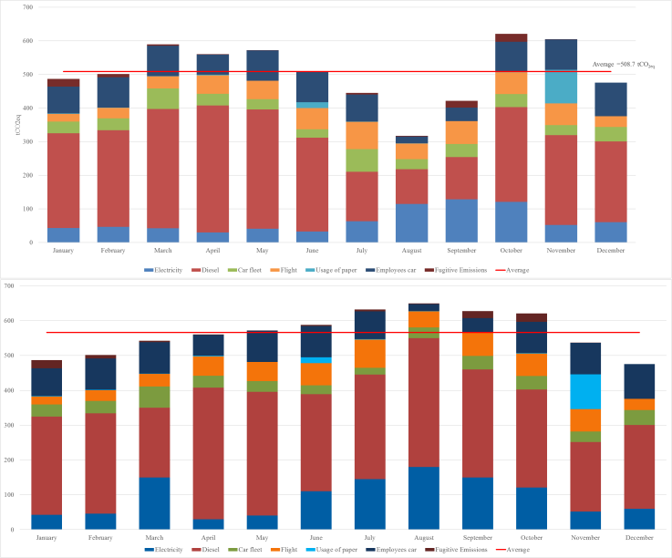
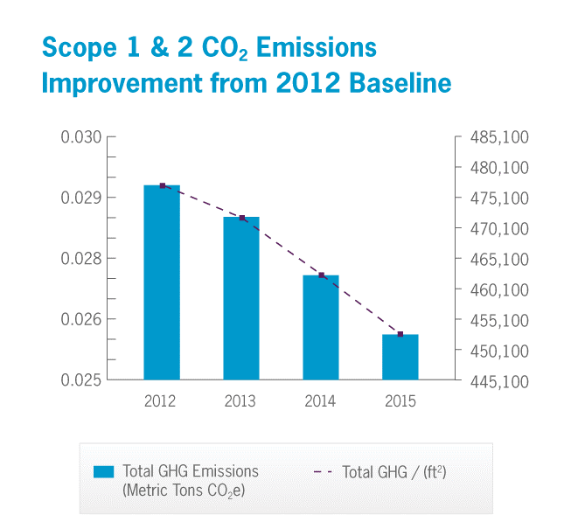
    Monthly GHG Audit

Slide 78
    Reduction Initiatives
Link the GHG to the real costs of the company
Monthly Variation to check your process
Modify the process
Energy, paper audits
Implementations: Local Loans (NEEREA…)
Rely on more RE
National Energy Efficiency and Renewable Energy Action" (NEEREA) is a national financing mechanism initiated by the Central Bank of Lebanon (Banque du Liban-BDL) dedicated to the financing of green energy projects in Lebanon. It offers loans for energy efficiency, renewable energy and green buildings projects with interest rates as low as 0% and repayment period as long as 14 years. The NEEREA initiative receives the technical support of the LCEC by virtue of the memorandum of understanding signed between the Central Bank of Lebanon and the United Nations Development Programme (UNDP).

Slide 79
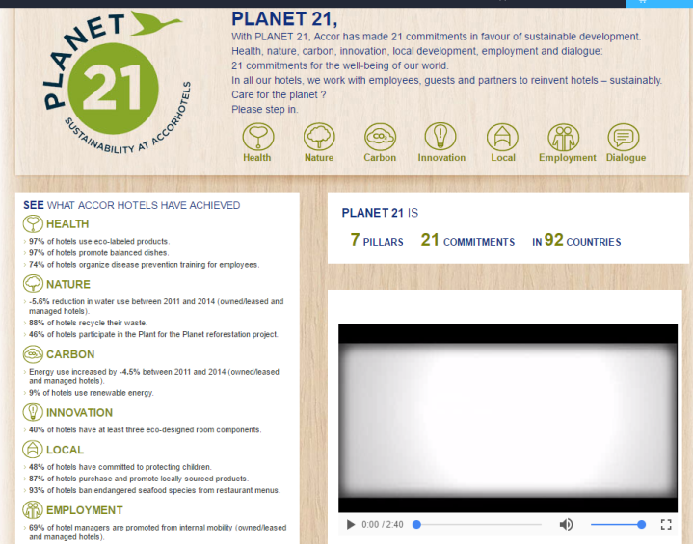
    Reducing CO₂

Slide 80
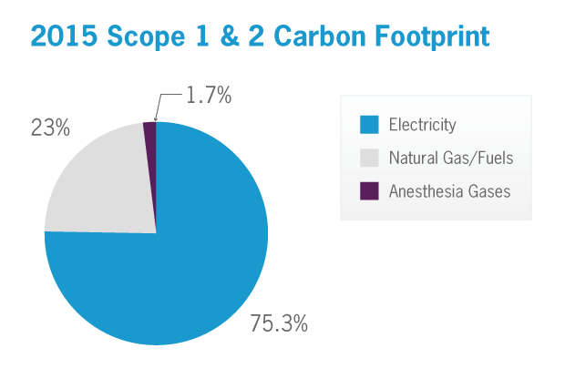
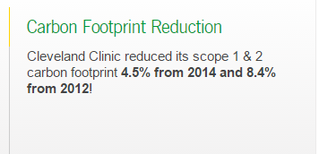
    Reducing CO₂
http://portals.clevelandclinic.org/ungc2016/Environment/ClimateResilience/tabid/9669/Default.aspx#294351511-carbon-mitigation

Slide 81
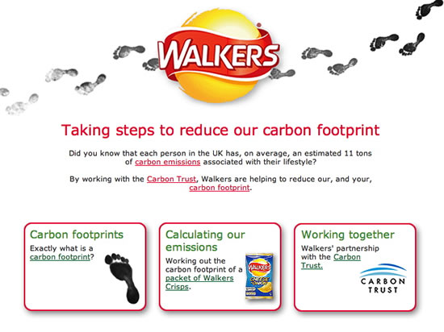
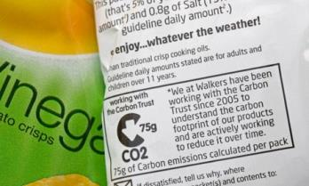

    Reducing CO₂

Slide 82
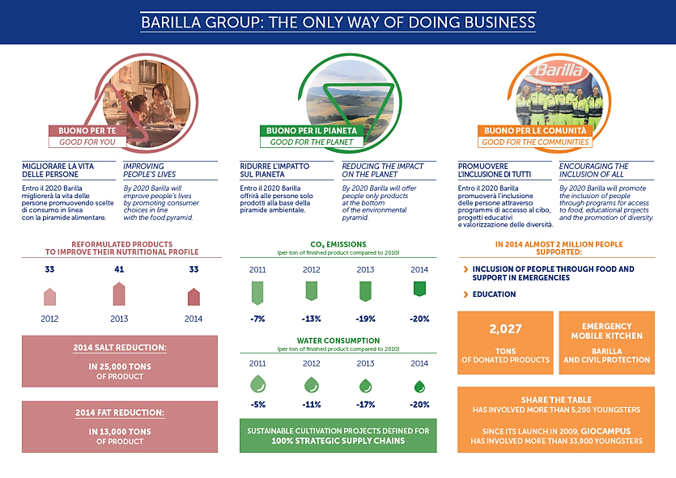
    Reducing CO₂

Slide 83
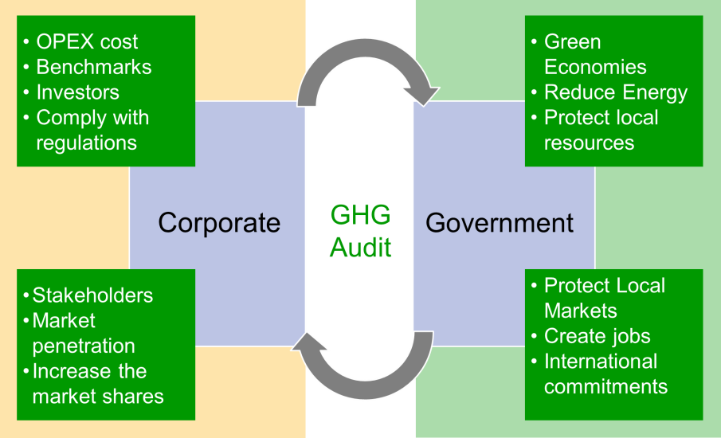
    Importance of the GHG Audit
www.V4Advisors.com

Slide 84
Key learning points

Slide 85
Module 5
Carbon footprint strategy
An action plan for the future

Slide 86
Key Questions
What are the key components of a Carbon footprint strategy?
What steps do I need to take internally?
Il Suffit D’ouvrir Les Yeux : COP22 - https://www.youtube.com/watch?v=cPUwtDjIaPk
Notes:
Movie COP22

Slide 87
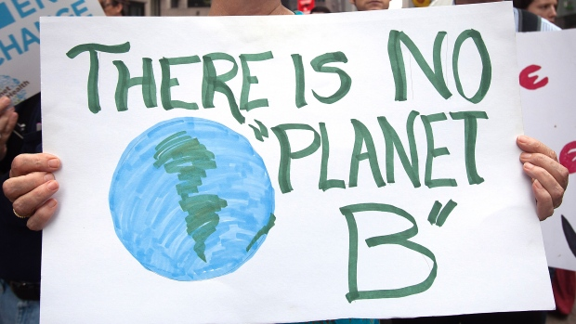
Notes:
http://i.cbc.ca/1.3002560.1439234776!/fileImage/httpImage/image.jpg_gen/derivatives/16x9_620/usa-climatechange-march.jpg

Slide 88
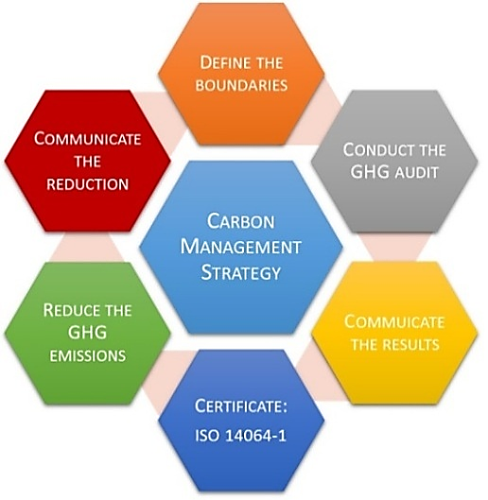
    Carbon Footprint Strategy
Notes:
Define the goal and scope of the study
Making a model of the product life cycle with all environmental inputs and outputs. The data collection effort is usually referred to as the life cycle inventory (LCI) stage
Understanding the environmental relevance of all the inputs and outputs. This is referred to as the life cycle impact assessment (LCIA) phase
The interpretation of the study

Slide 89

    ‘Waste’ CAN be Turned into a Resource
New growth and job opportunities
Better eco-design, waste prevention and reuse can bring net savings for EU businesses of up to EUR 600 billion
Reduction of total annual greenhouse gas emissions
Increased resource productivity by 30% by 2030 could boost GDP by nearly 1%, while creating 2 million additional jobs
Visit: http://ec.europa.eu/environment/circular-economy/
Notes:
http://ec.europa.eu/environment/circular-economy/
Re-using, repairing, refurbishing and recycling existing materials and products.
All resources need to be managed more efficiently throughout their life cycle. ‘waste’ CAN be turned into a resource.
Using resources more efficiently will also bring new growth and job opportunities. Better eco-design, waste prevention and reuse can bring net savings for EU businesses of up to EUR 600 billion, while also reducing total annual greenhouse gas emissions. Additional measures to increase resource productivity by 30% by 2030 could boost GDP by nearly 1%, while creating 2 million additional jobs.

Slide 90
    Performance Measures
Good Performance Measures:
Provide a way to see if our strategy is working
Focus on what matters most to success
Allow measurement of accomplishments, not just of tasks
Provide a common language for communication
Are explicitly defined in terms of owner, unit of measure, collection frequency, data quality, expected value (targets), and thresholds
Measure the right things
Ensure data collection accuracy
Notes:
Good Performance Measures:
-Provide a way to see if our strategy is working
-Focus employees' attention on what matters most to success
-Allow measurement of accomplishments, not just of the work that is performed
-Provide a common language for communication
-Are explicitly defined in terms of owner, unit of measure, collection frequency, data quality, expected value (targets), and thresholds
-Are valid, to ensure measurement of the right things
-Are verifiable, to ensure data collection accuracy
Establishing Sustainability KPIs is useful for, among others:
• Regulators or stock exchanges contemplating increased targeted
requirements for sustainability reporting
• Corporations seeking to enhance the credibility of their sustainability
reporting and improve its integration into financial reporting on material factors
• Stakeholders seeking to better understand the most important
elements of a corporation’s sustainability performance
• Investors seeking to improve the sustainability analysis they incorporate into their assessment so of company value

Slide 91
    Strategy Exercise
SELECTED ORGANISATION
Environment Objective:
Area/Issue | Measures KPIs | Targets | Initiatives
Social Objective:
Area/Issue | Measures KPIs | Targets | Initiatives
Corporate Governance and Strategy
Workplace Objective:
Area/Issue | Measures KPIs | Targets | Initiatives
Marketplace Objective:
Area/Issue | Measures KPIs | Targets | Initiatives

Slide 92
    A road-map
Pillar: Environment Company Strategic Objective:
Climate Change Topic | Measures KPIs | Target | Initiative | Initiative Resources | Initiative Timeline | Initiative Goal

Slide 93
    For each Initiative
Stages | Who is responsible for this stage? | Who will be involved in this stage (departments/functions, roles names) | Milestones/ Deadline | Financial requirements | What is the objective of each step
Kick off meeting
Identify stakeholders and consult with them
Finalise initiative details: KPIs, timeline, etc & set SMART goals
Start Initiative
Monitor indicator/progress every X weeks
Report progress
Corrective activities (if required)
Communicate results to stakeholders
Overall Project responsible

Slide 94
    Kick off meeting agenda example
Meeting Agenda
Date
Time
Location
Meeting called by
Timekeeper
Secretary
Attendees
Please read/prepare before meeting:
Agenda Items
Topic | Presenter |  | Time Required
Decisions
Document each project decision reached. Indicate follow-up actions. Assign responsibility and a target date for completion.
Decision Description | Action Required | Responsible | Target Date

Slide 95
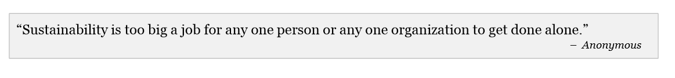
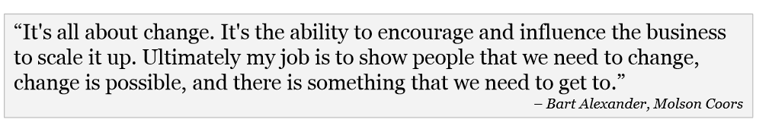

    The Key Skill: Communication!
Notes:
pwc-sustainability-executive-profile-and-progress.pdf

Slide 96
Closing remarks

Slide 97


Thank You!
Aglaia Ntili
Managing Director
+30 6972031126,
+971 553231190
www.SustainabilityKnowledgeGroup.com
Rawad Massoud
Executive Managing Director
+961 71 139943
+961 9 911 953
www.V4Advisors.com
in cooperation with

